Slide 1
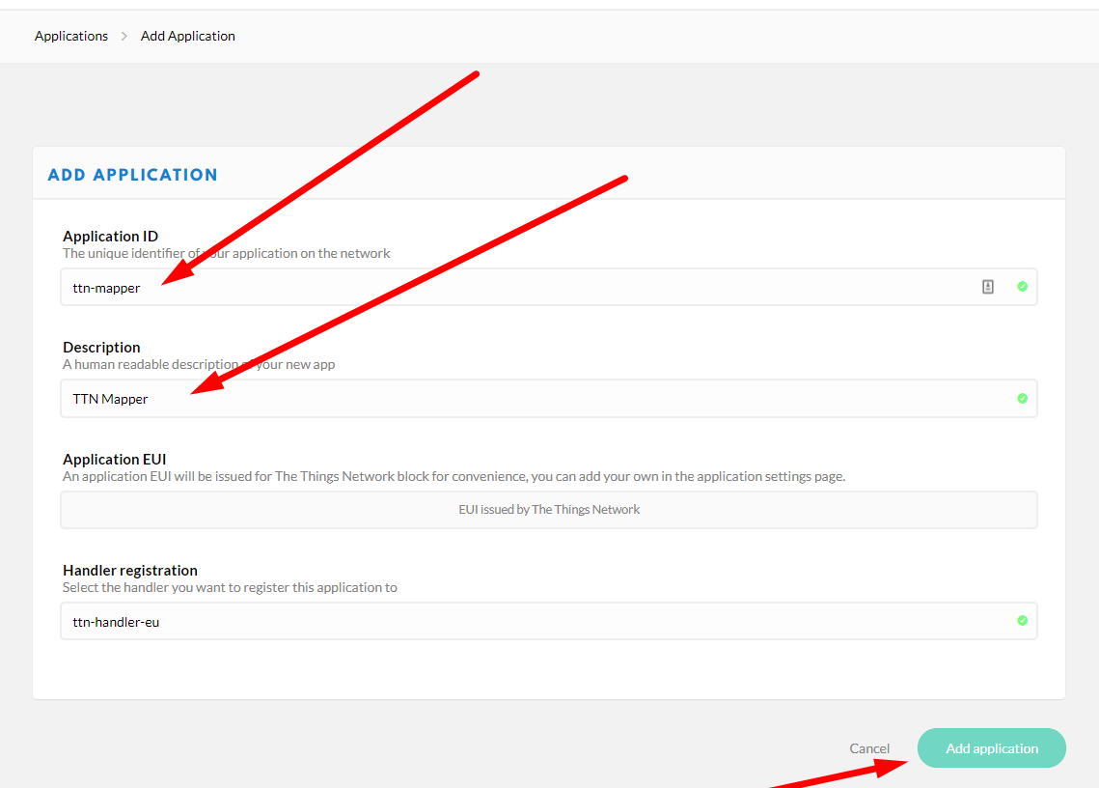

Create Application in TTN Console

Slide 2
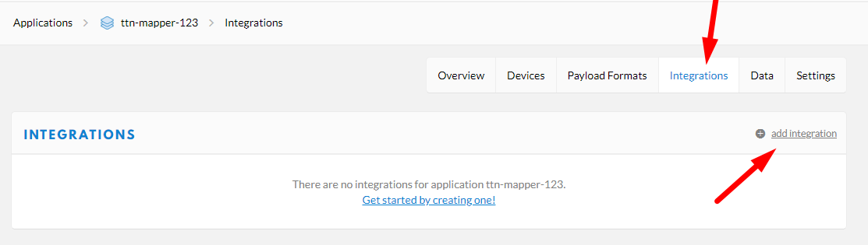
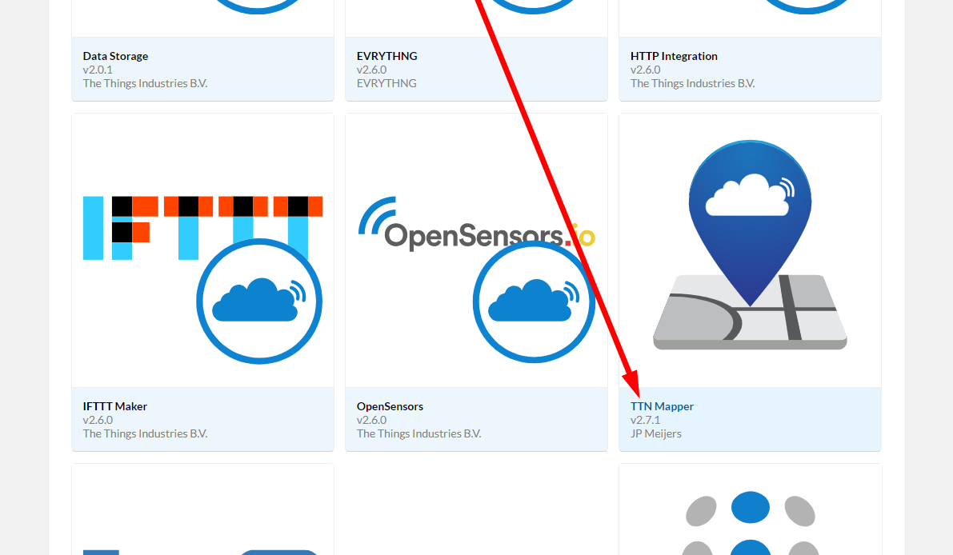
Add the TTN Mapper Integration

Slide 3
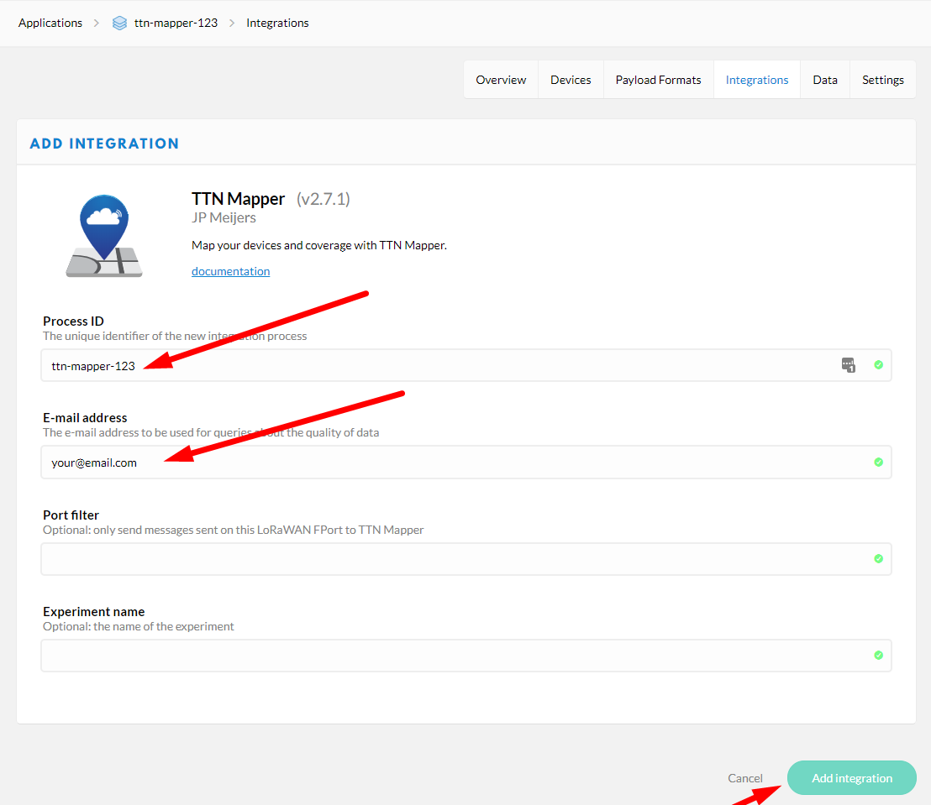
Configure TTN Mapper

Slide 4
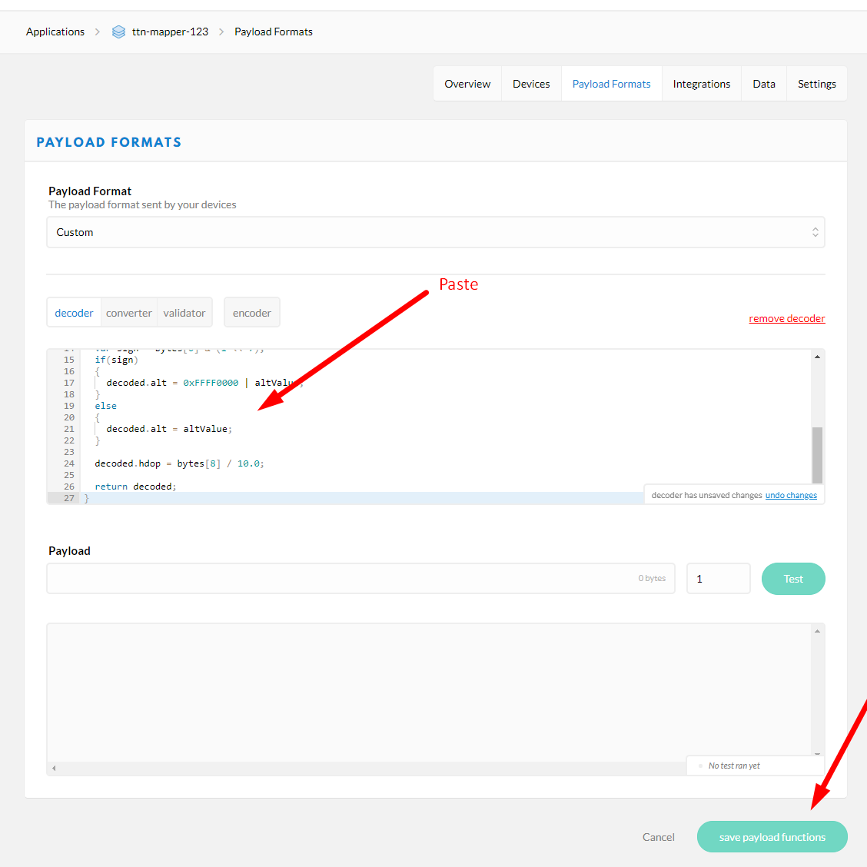
Update the Encoder

Slide 5
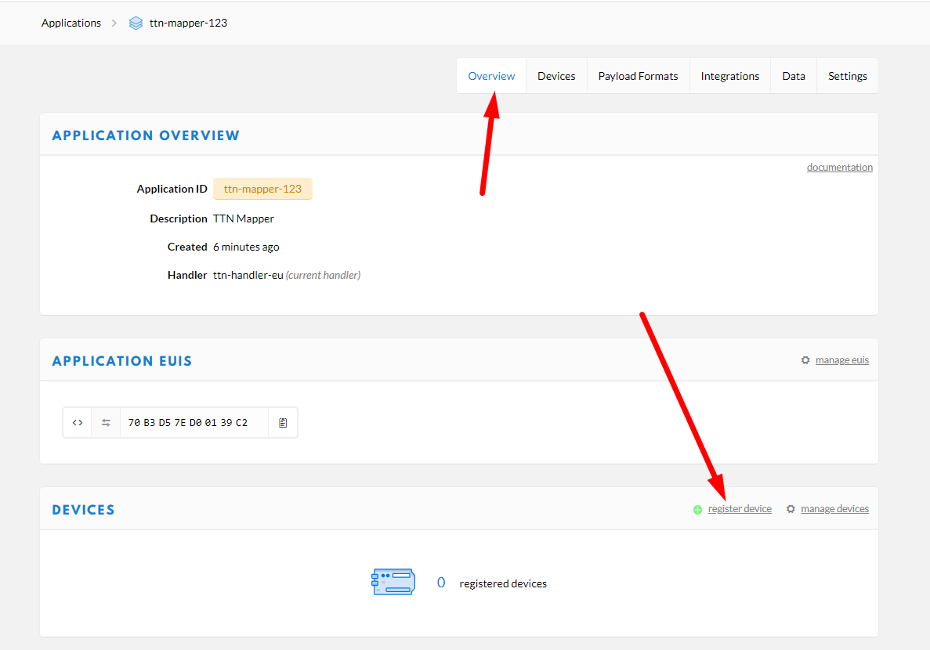
Register a Device

Slide 6
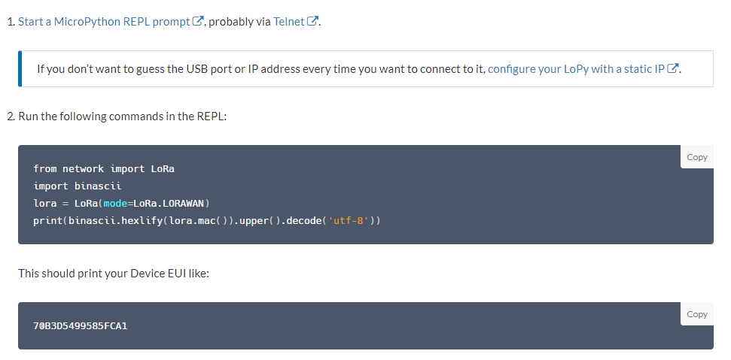
Get the Device EUI
https://www.thethingsnetwork.org/docs/devices/lopy/usage.html

Slide 7
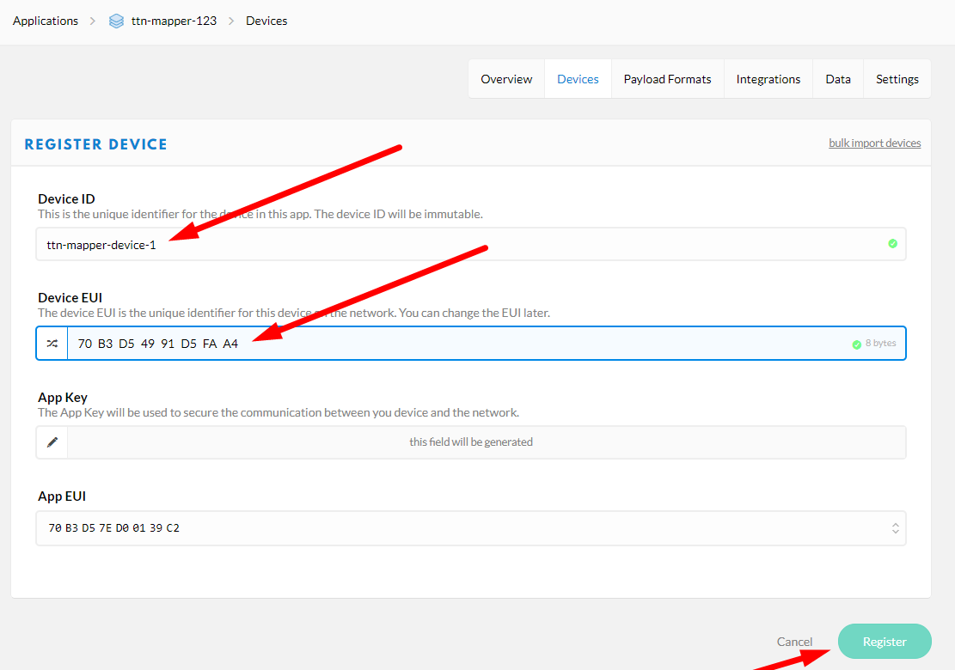
Complete Device Registration

Slide 8
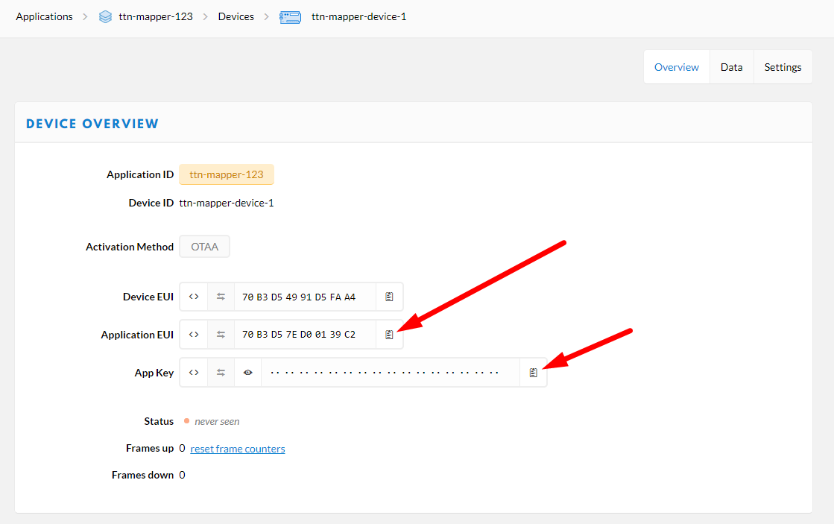
Get App Settings

Slide 9
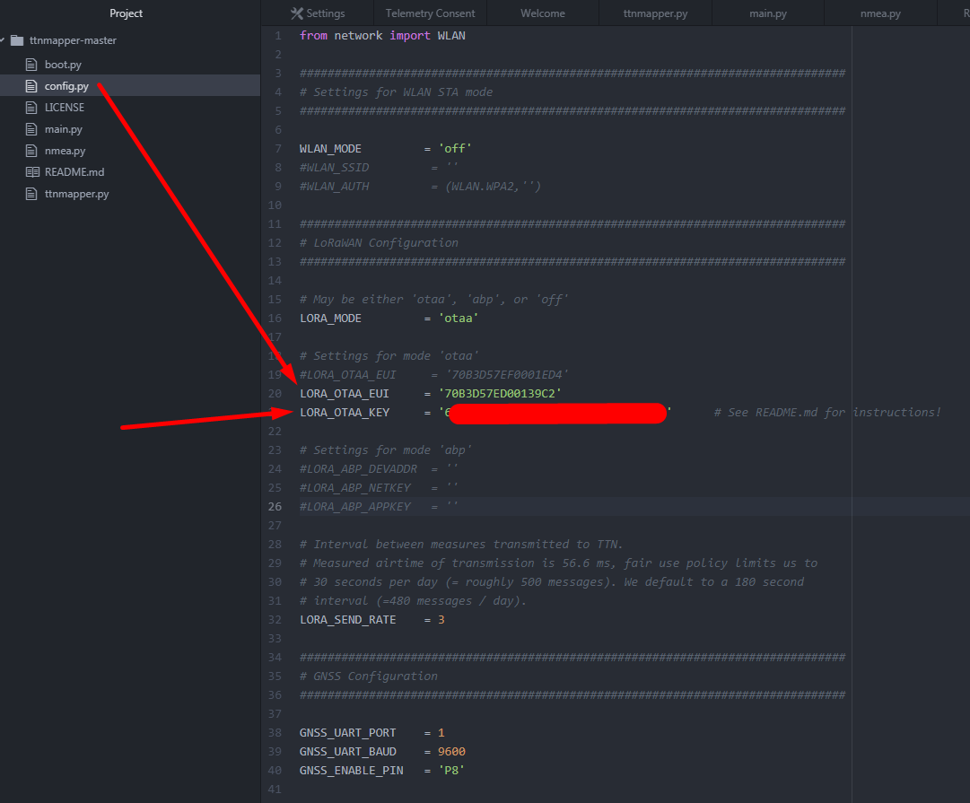
Update config.py

Slide 10
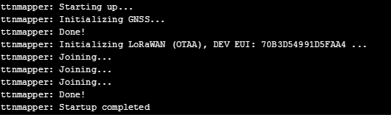
Monitor REPL

Slide 11
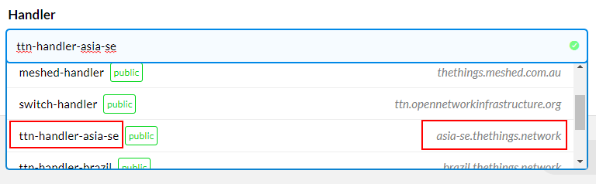
Get TTN Mapper Phone App (Andriod or iOS)
Not needed if a GPS module is used, although is handy for “observations”
With GPS module: If your LoRa device has a GPS the mobile phone App isn’t essential but a good visual aid to your track path (a lock of 3 satellites min. is required to record your track, Pycom LED will indicate good tracking)
Without GPS module: If you don’t have a GPS on your LoRa device the mobile phone’s GPS is used for your location tracking. So keep them “together” during your LoRa survey.
See: https://www.thethingsnetwork.org/labs/story/using-ttnmapper-on-android
Use this for generating a QR code https://www.qr-code-generator.com/
Example format (modify to suit your own settings)
Format: https://{ttn-handler}:{ttn-appl-id}:{ttn-device-id}:{ttn-appl-access-key*}
Example: http://asia-se.thethings.network:ttn-mapper-123:ttn-mapper-device-1:ttn-account-v2.oq1wWxXXX
WARNING: Don’t share your ttn-appl-access-key on publically

Slide 12
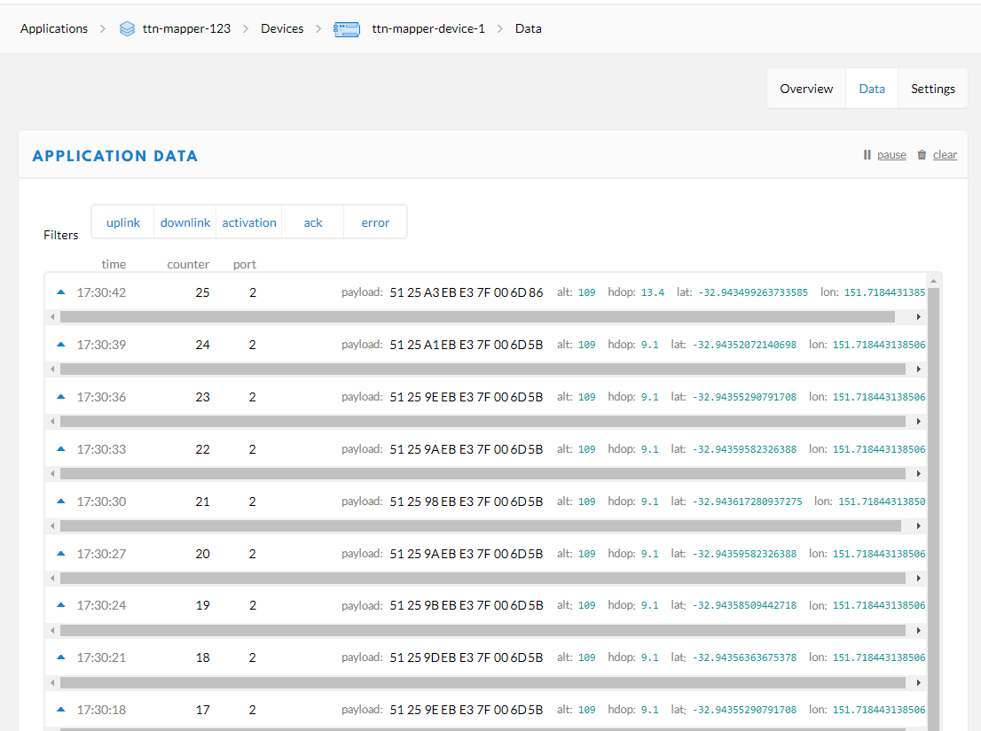
Monitor TTN Console (when there is GPS reception)

Slide 13
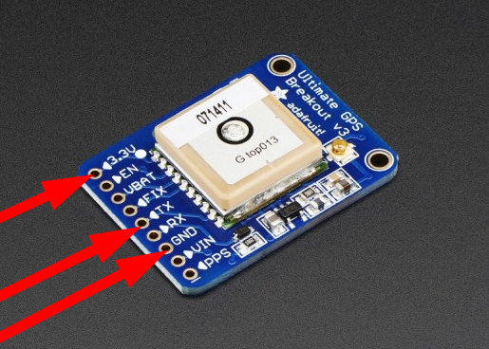
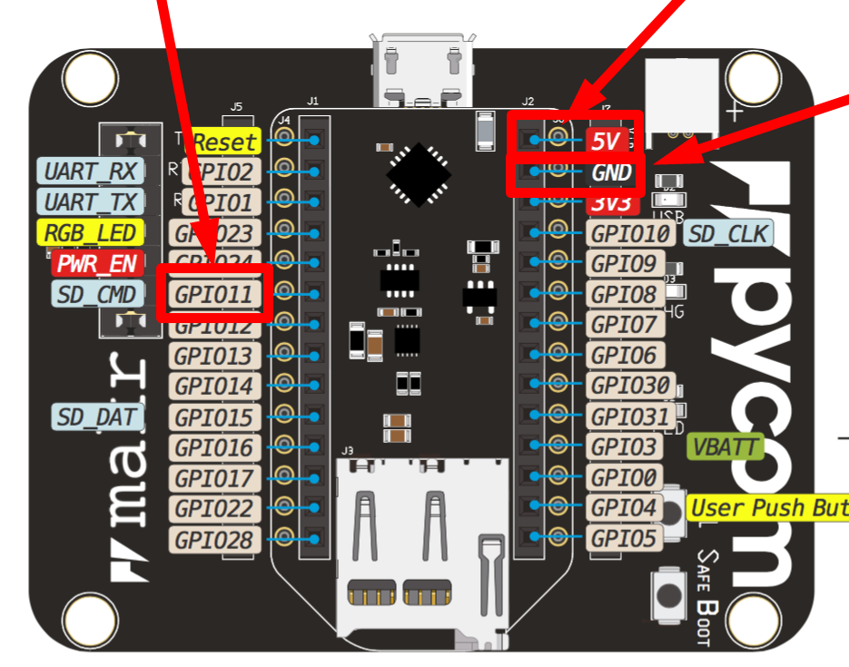
Hardware Hookup
Pycom Makr | Ultimate GPS | Note
5V | 3.3V | Vin 3.3-5.5Vdc
GPIO11 | TX | NMEA data
GND | GND

Slide 14

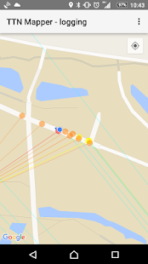
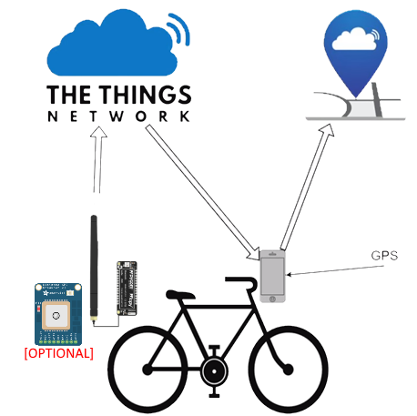
https://www.youtube.com/watch?v=Y9lMvyTYI3E

Slide 15
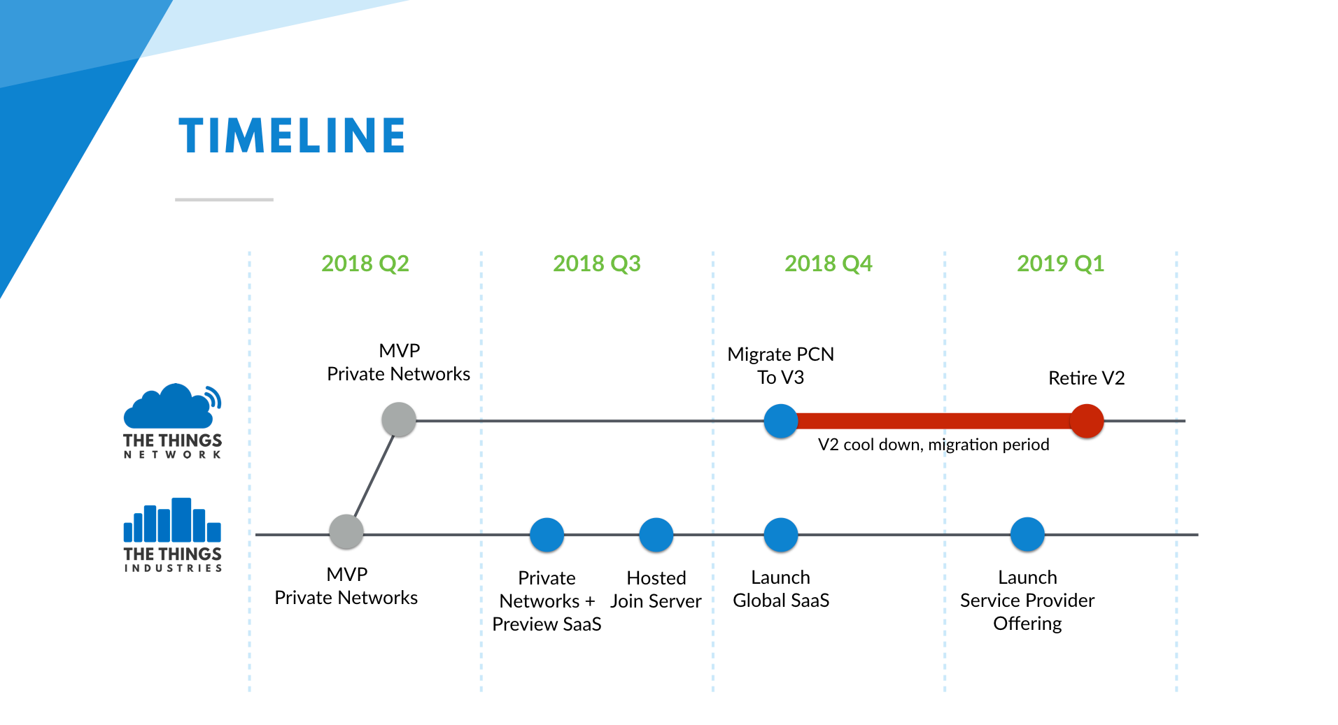

Slide 16
